Slide 1



DC Water Asset Management
Project – 4
And
Final
Presentation
April 22, 2024
Erin Cooper
Eyasu Yilma

Slide 2
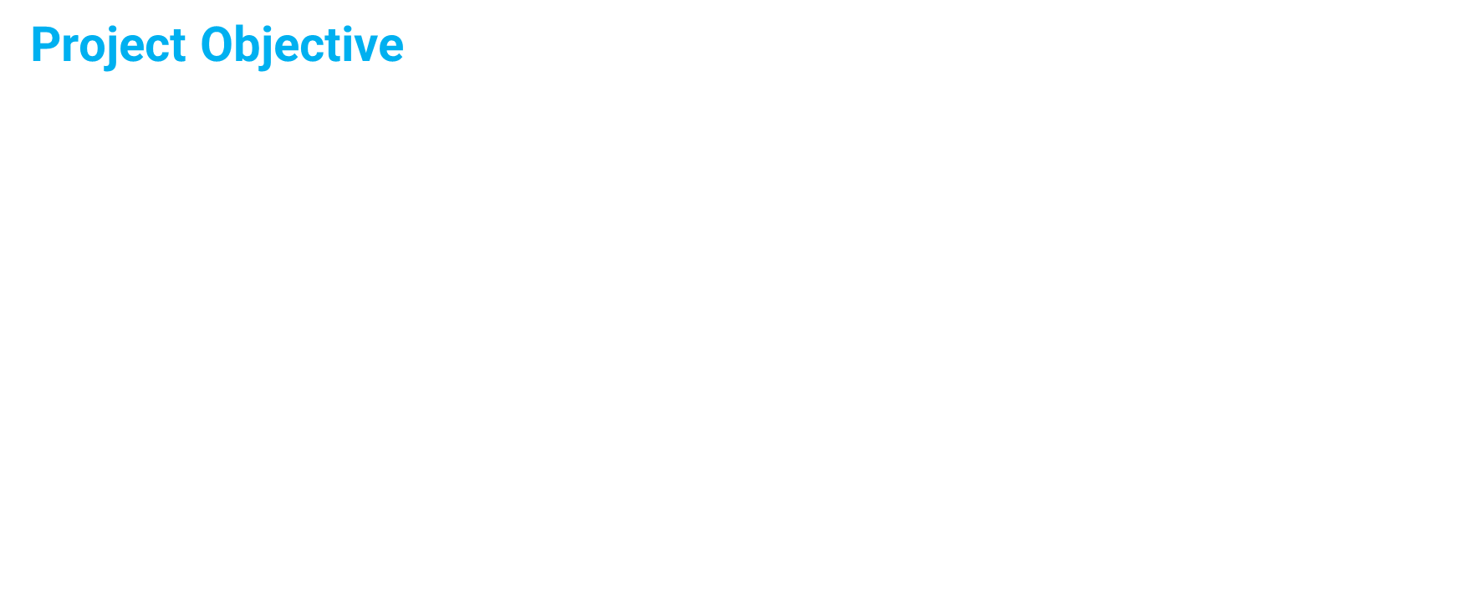
Predict Risk to Critical DC Water Assets and
Determine Cost Impact to various User Jurisdictions
Notes:
DC Water asset, the Potomac Interceptor, is a 50 mile long series of pipes that brings water to 1.6 million people from Fairfax, VA to parts of DC and Mongomery County, MD. When a pipe segment is damaged or degrades to the point that it is no longer safe it can be expensive to repair and the costs of those repairs might be shared between jurisdictions depending on whether or not that pipe segment shares territor with a neighbor. Our project took a look at Patomac Interceptor pipe system in order to predict risk to critial water assets and determine the cost impact to various user jurisdictions.

Slide 3
Project Workflow Chart
SQL
Flow per user
Python Pandas
Data Import
(IBM Maximo & DC Water Report
Flow
and cost analysis
User Cost Share
Cost Impact of Collapse
SQL
Labor Hour Per Location
Tableau
Leaflet
Visualization
Location Description
ML
ML
ML
Pipe Condition
Inspection cycle
Predict
Risk per location
Notes:
As pictured in the flow chart here, we used SQL to join labor data from IBM Maximo and water flow data from the DC Water Report to calculate flow per user labor hours per location. We then exported that data for use in our cost and flow share analysis and our machine learning risk prediction model per location and created vizualiztions in Tableau.

Slide 4
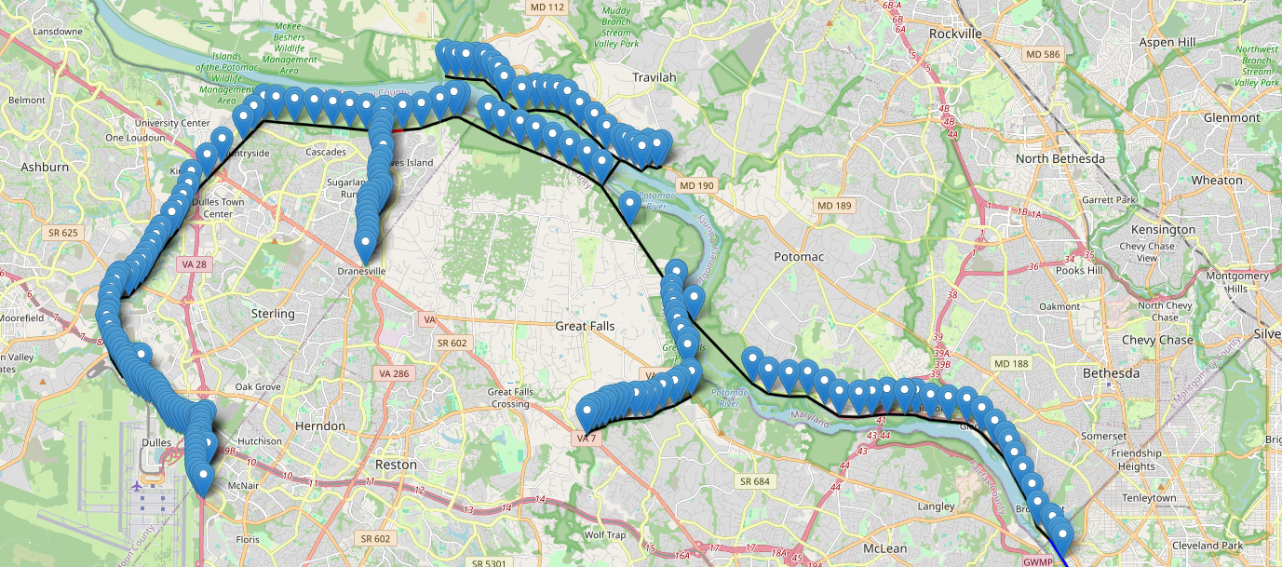
DC Water Asset, The Potomac Interceptor, serves 1.6 million, 55 mgd, 50 mile long
Notes:
We also produced a Leaflet map of the manholes serving each pipe segment with popups displaying each segment's coordinates as well as the length, slope, and pipe diameter over the entire selected water flow route.

Slide 5
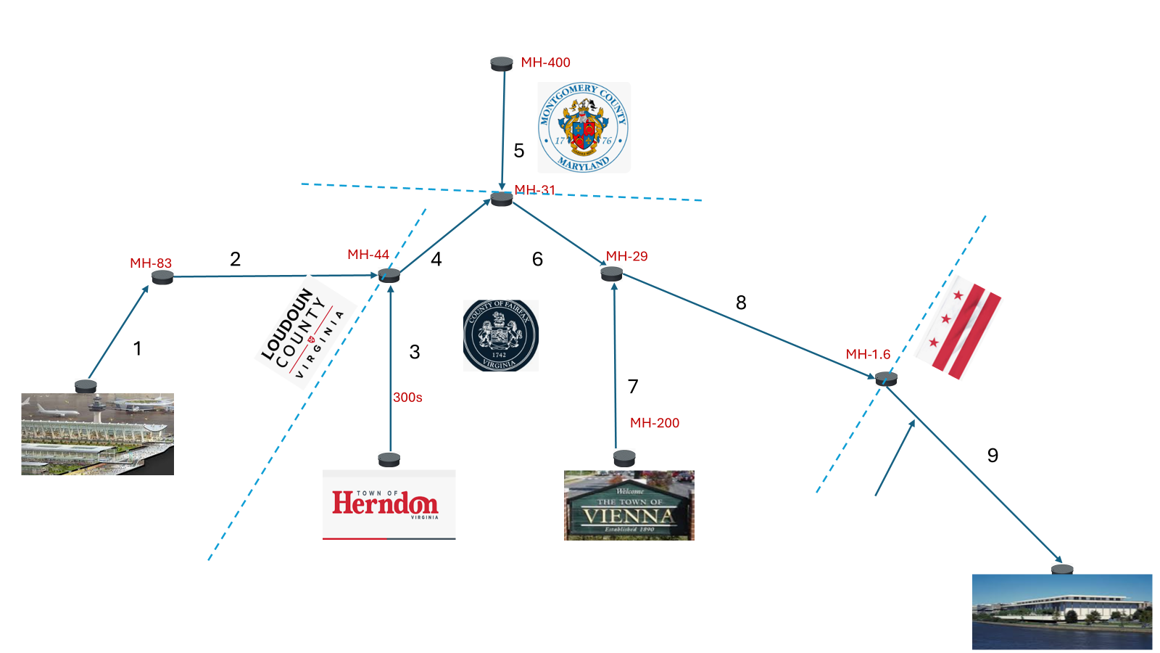
Notes:
And the following chart lays out where each jurisdiction meets up along the length of the Potomac Interceptor's route, starting in Dulles and branching into Herndon, Montgomery County, MD, and into the District and what manholes specifically delineate those borders. Each branch is numbered. These are the primary flow divisions in our data and will be used to calculate cost and flow share and the pipe inspection data will be used to populate our risk prediction model.

Slide 6


Risk Prediction
Using
Supervised Machine Learning

Slide 7
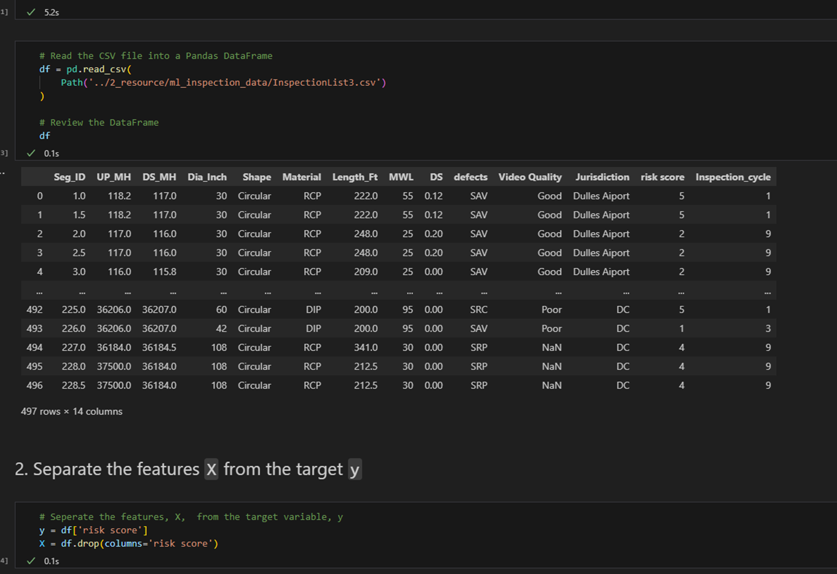
Reading CSV File
Data Import
Target & Feature
Separation

Slide 8
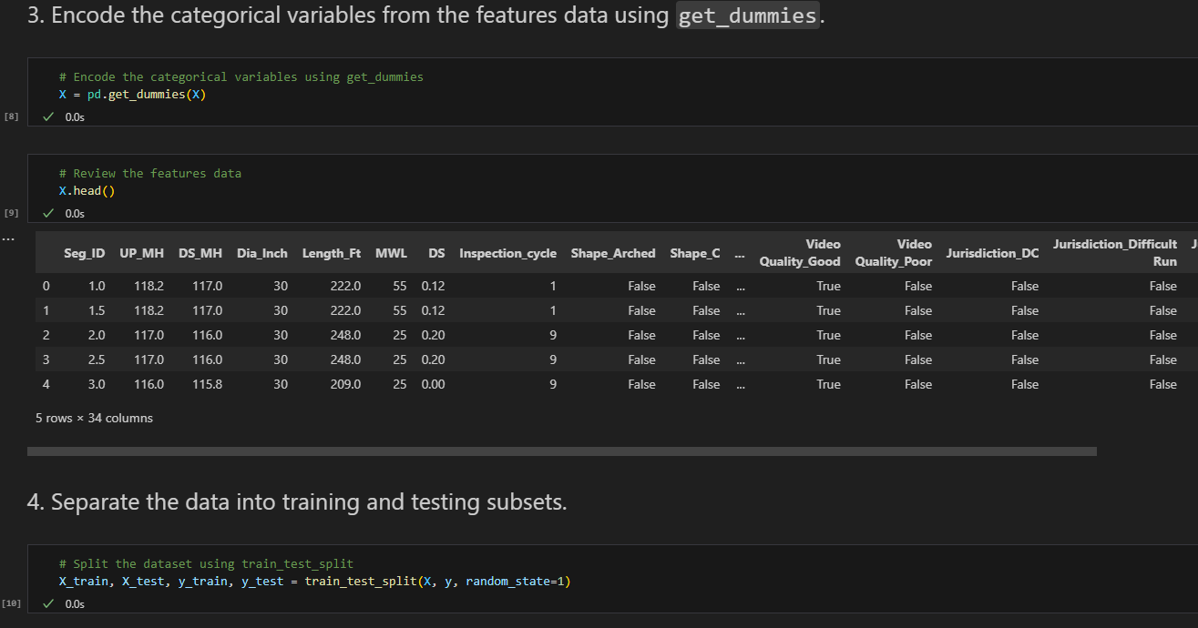
Encode the categorical variables using get_dummies
Get dummies
Separate Data
Training & Testing Subset

Slide 9
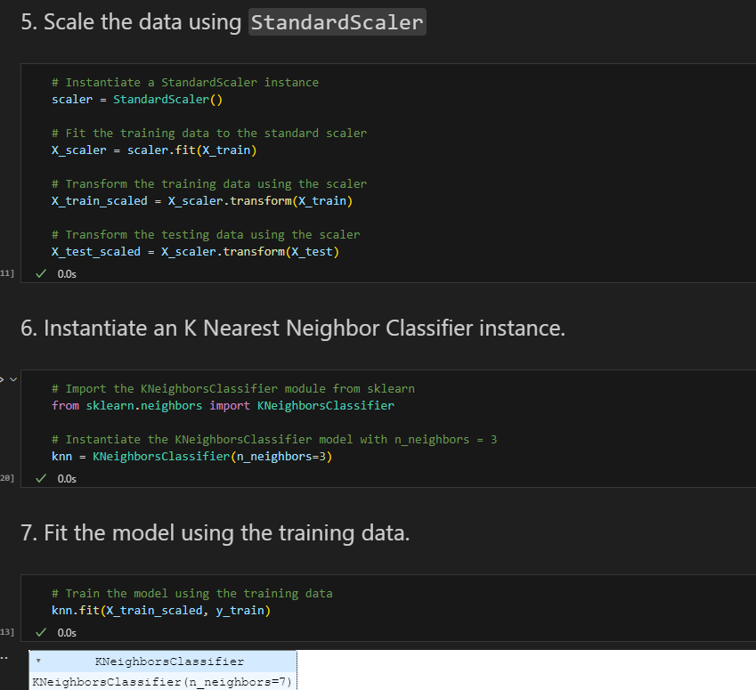
Scale the & Sklearn
Scale data
Instantiate Classifier Instance
Fit the Model with Training data

Slide 10
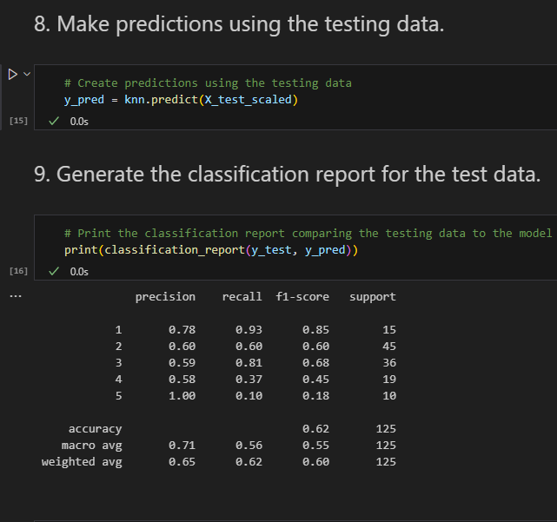
Make Prediction

Slide 11
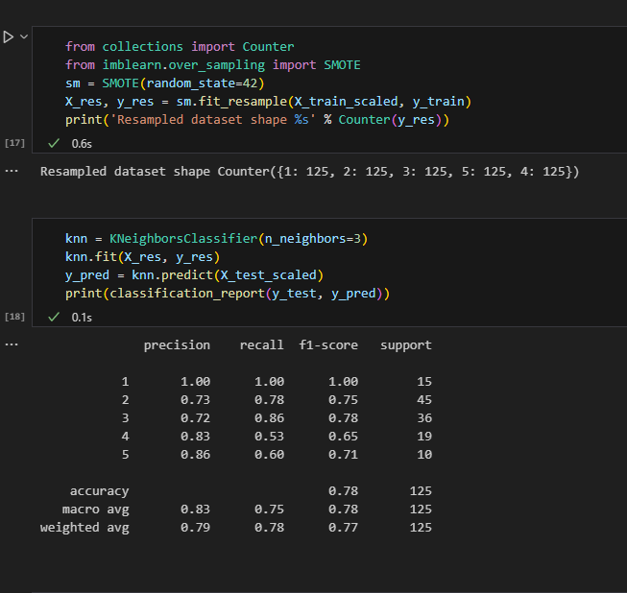
Resampled Dataset

Slide 12
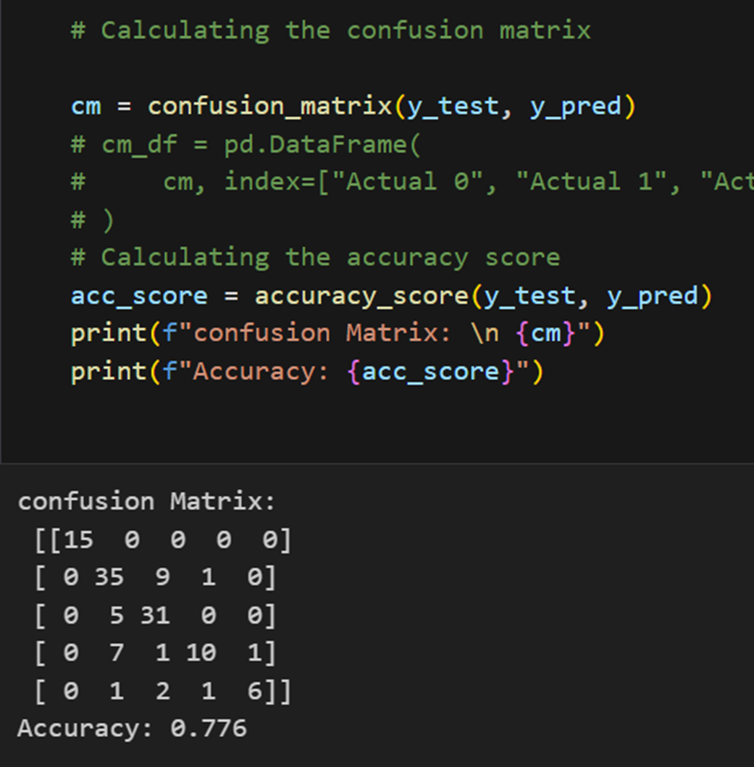
Confusion Matrix

Slide 13

Flow Share Calculation
Using
SQL
Python Pandas

Slide 14

Data Acquisition
Maximo - Labor hours per Job number
User Jurisdiction - Flow Report
DC Water - Asset Database
Consultant/Contractor Report - Pipe Inspection data

Slide 15
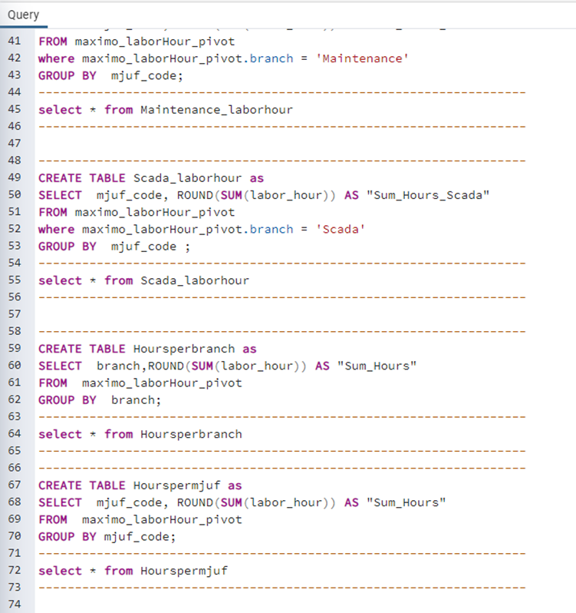
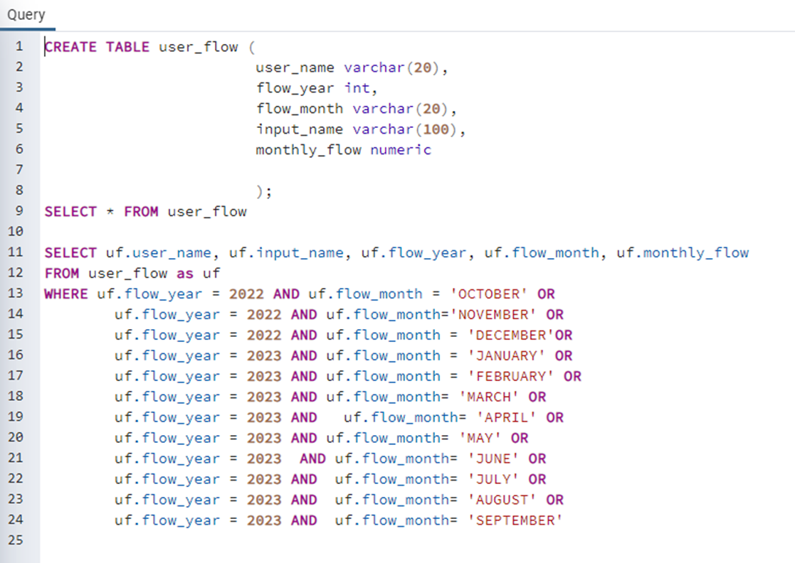
Data Preprocess and Filtering
Upload in SQL
Join using location Id
Download CSV
Import Python Pandas

Slide 16
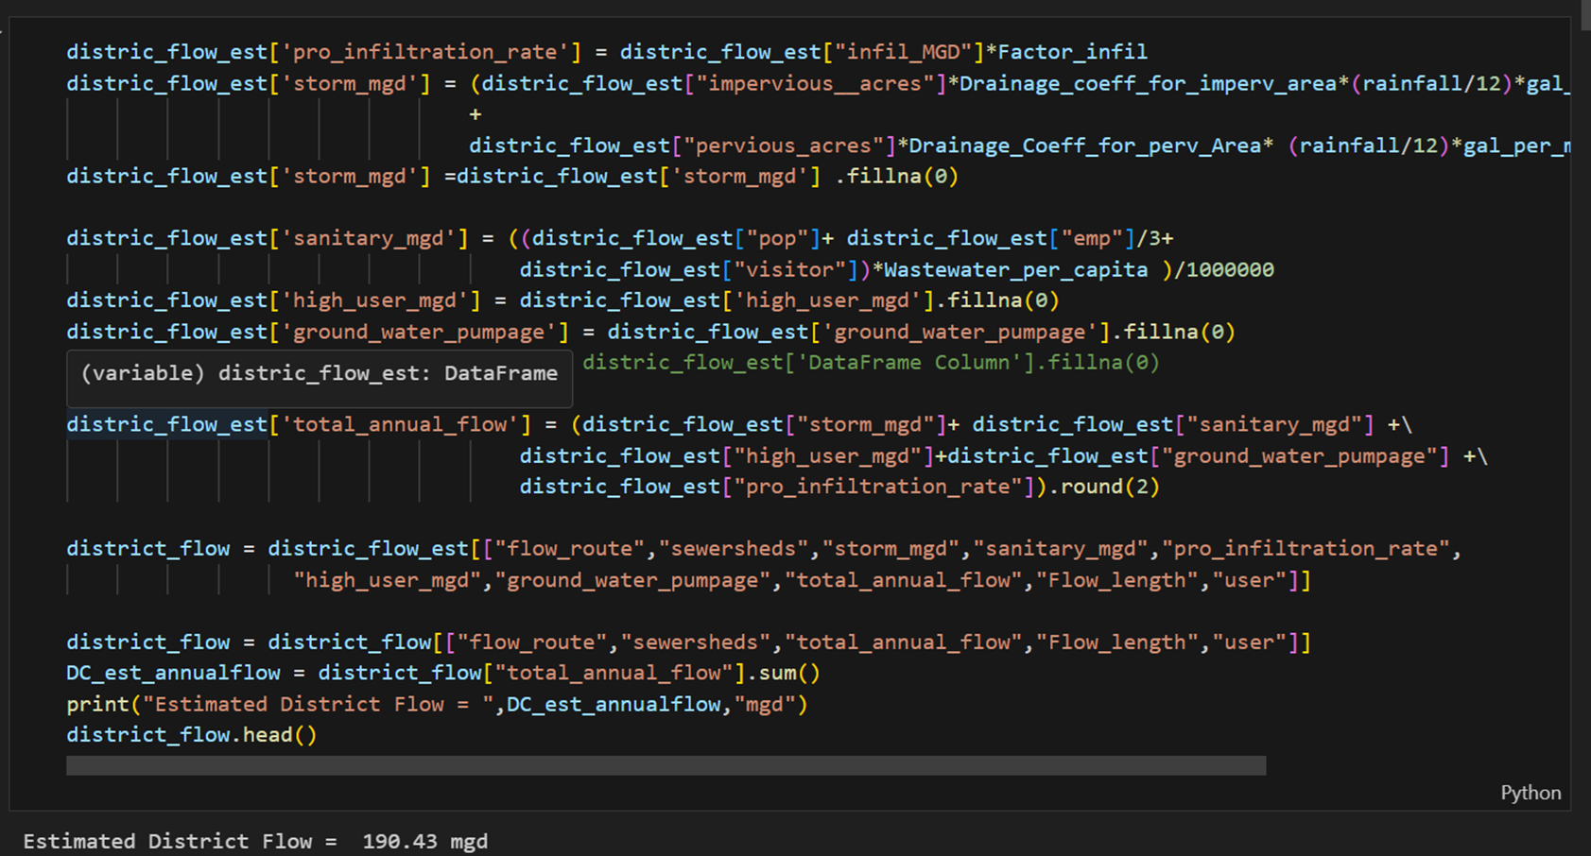

District Flow

Slide 17
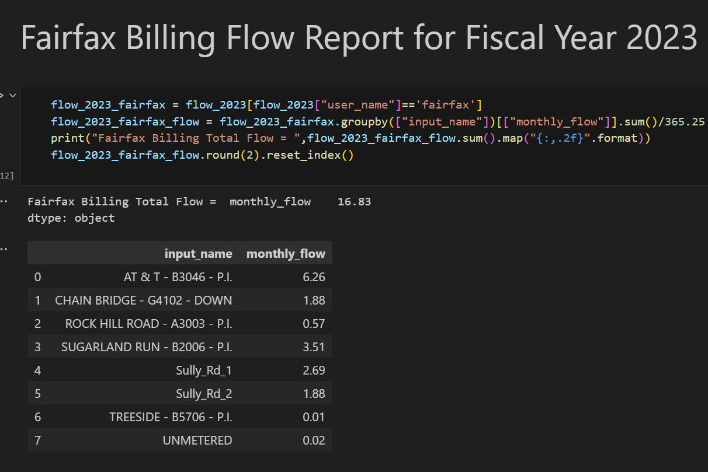

Suburban User

Slide 18
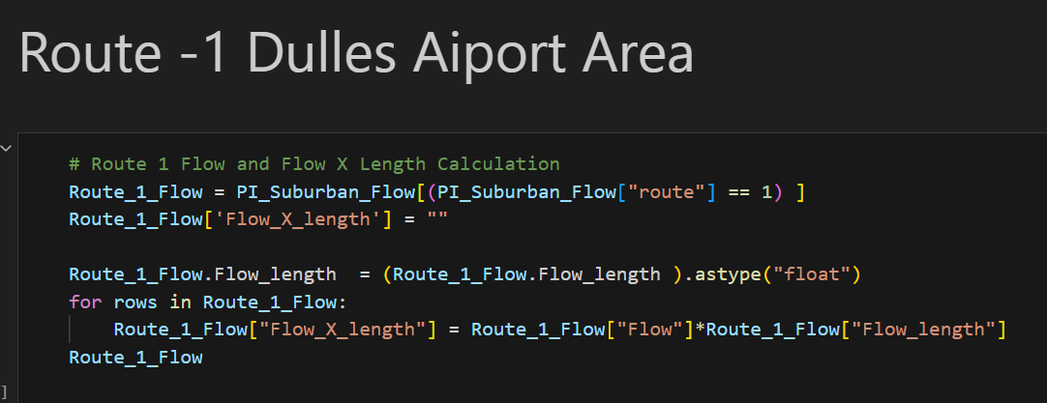

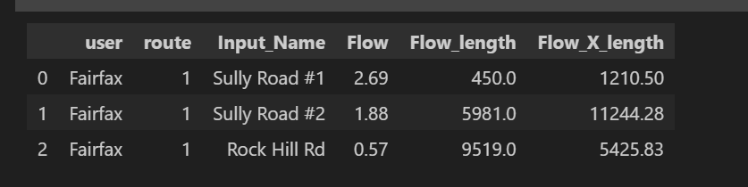
Flow Share Cont’s

Slide 19
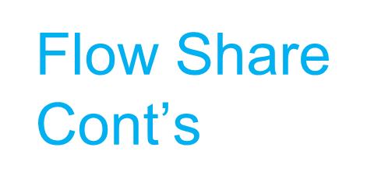
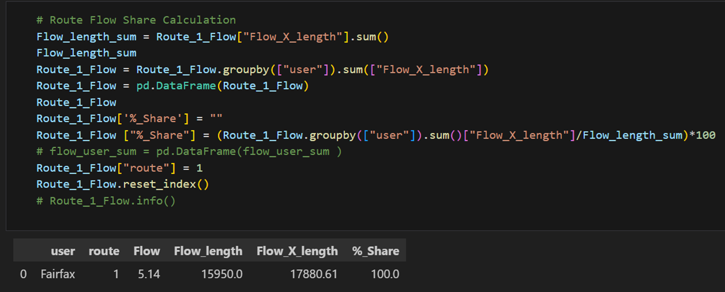

Slide 20
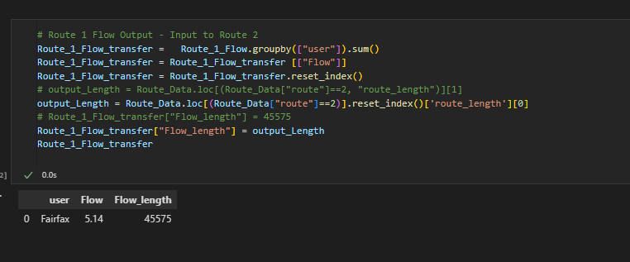

Slide 22
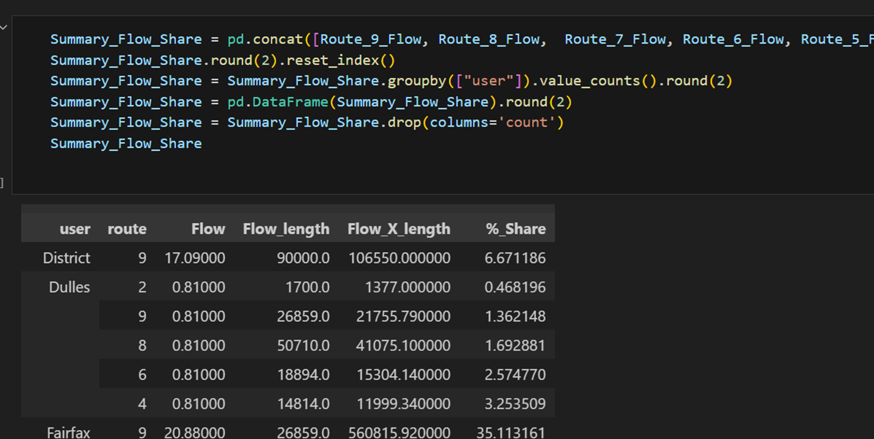

Slide 23

Output and Visualization with Tableau

Slide 24
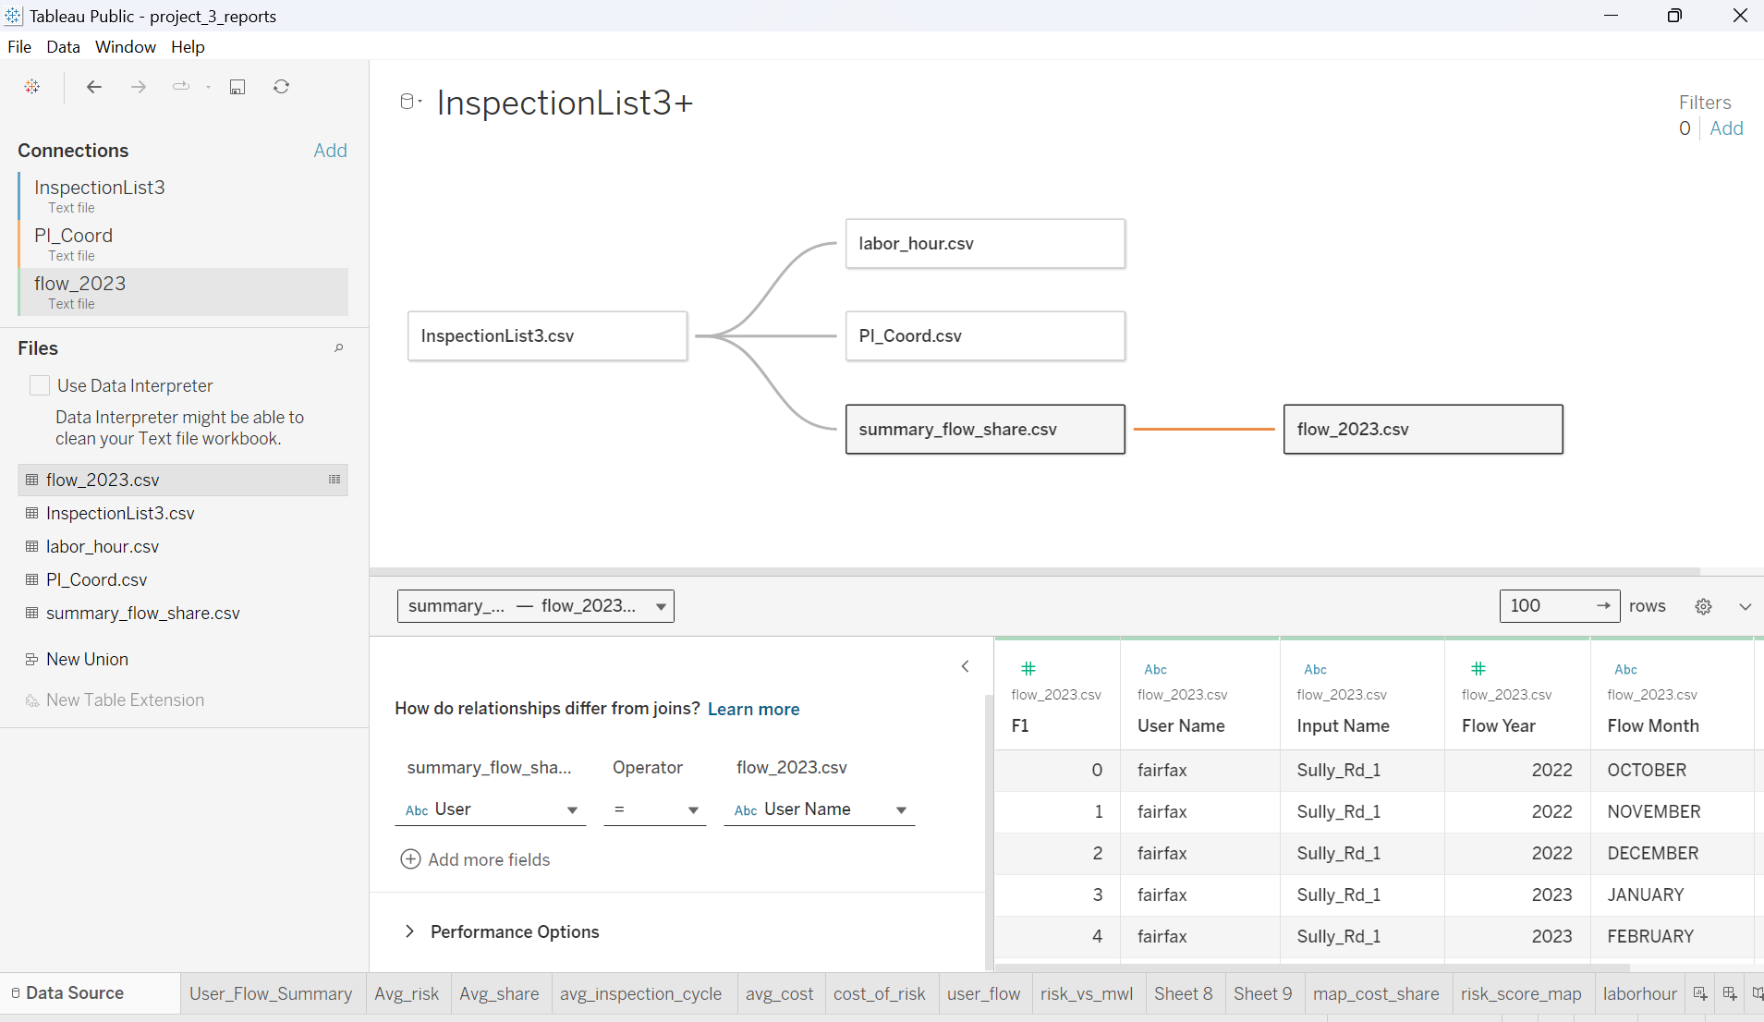

Slide 25
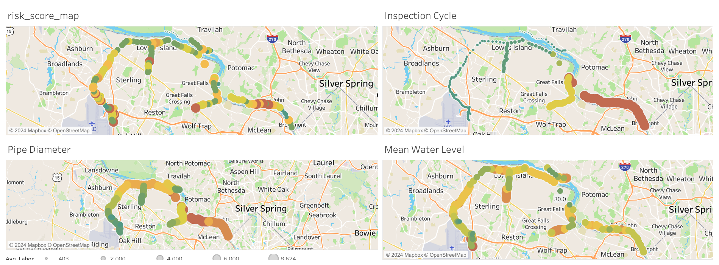

Slide 26
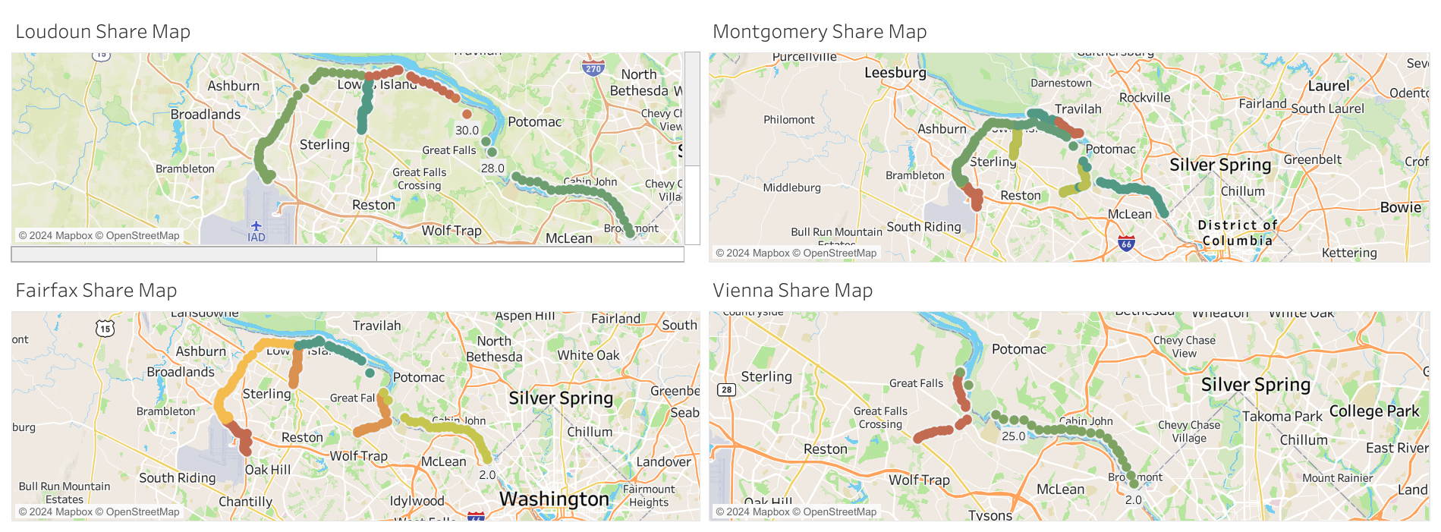

Slide 27
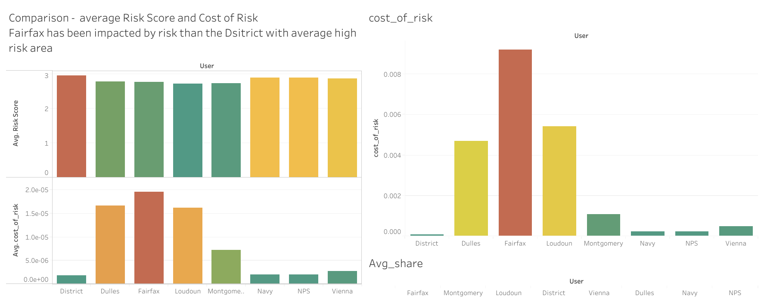

Slide 28
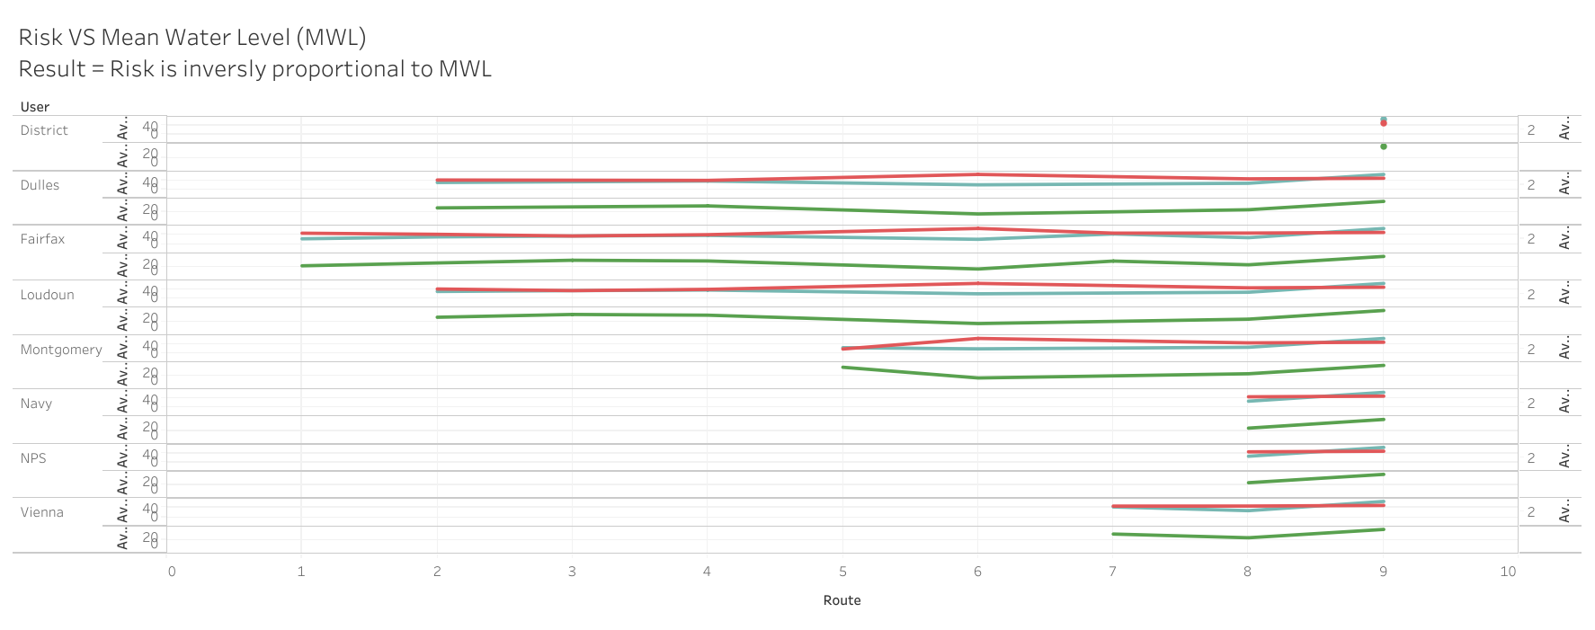

Slide 29


Thank You !

